Slide 1
PA2312044010024 VIJAYANANTH U CT-3 Project Advanced Data Visualization Using Tableau(IPL DATASET)
File created on: 5/12/2024 9:31:24 AM

Slide 2
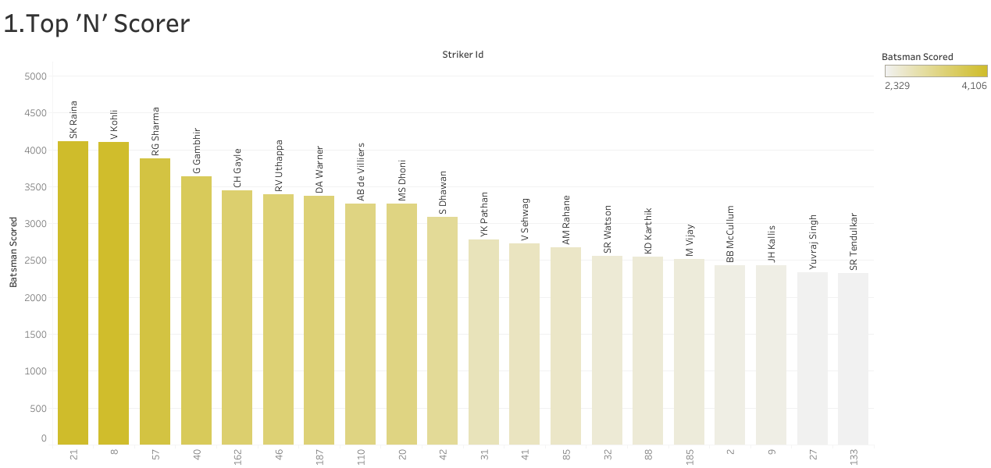

Slide 3
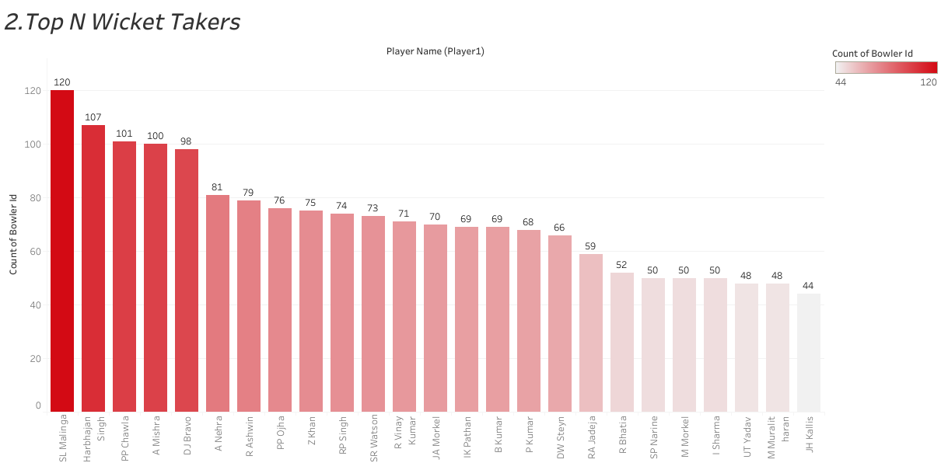

Slide 4
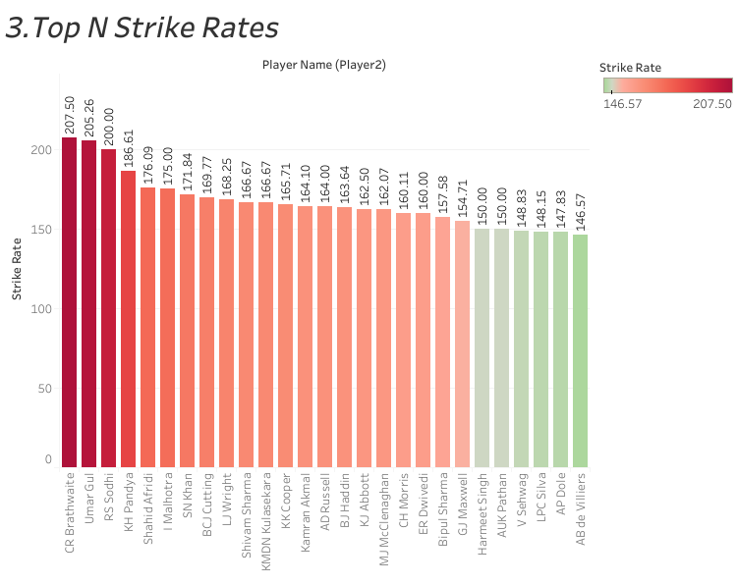

Slide 5
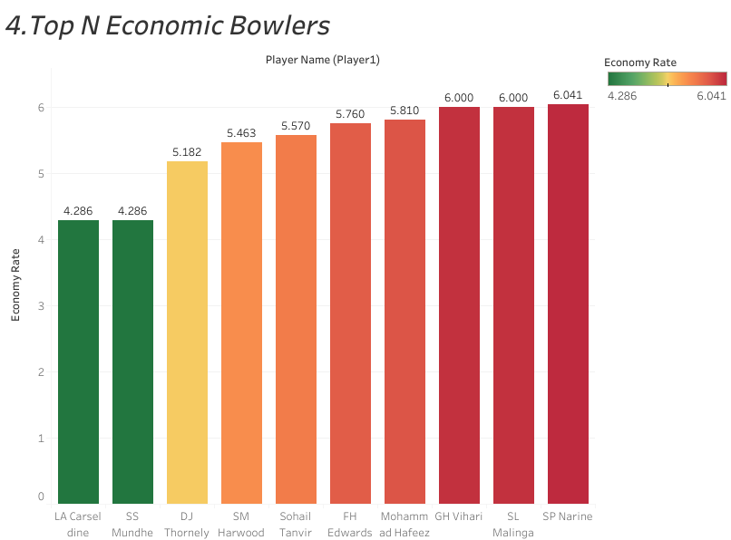

Slide 6
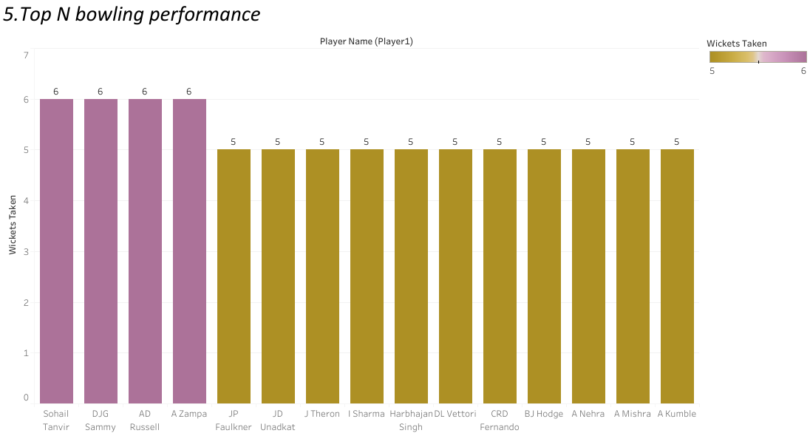

Slide 7
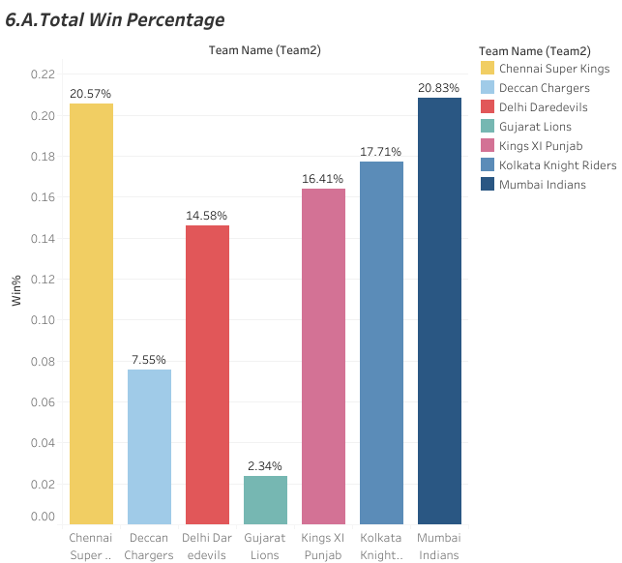

Slide 8
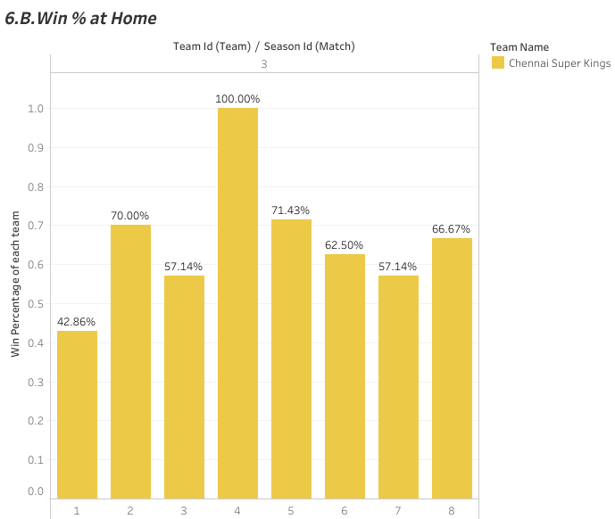

Slide 9
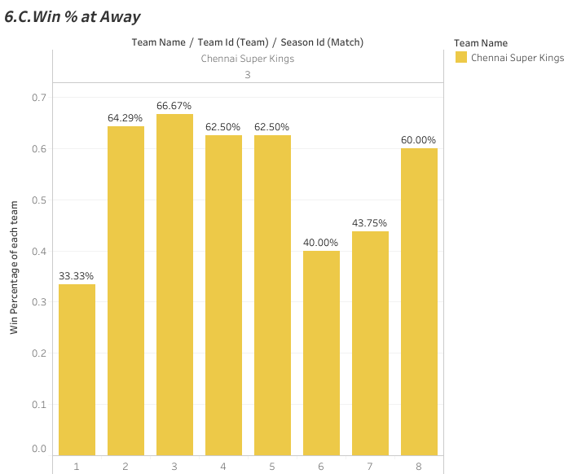

Slide 10
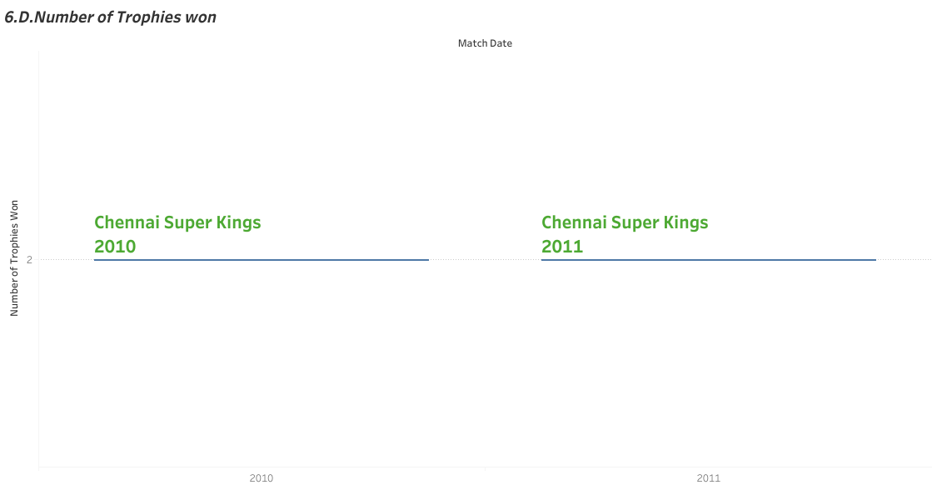

Slide 11
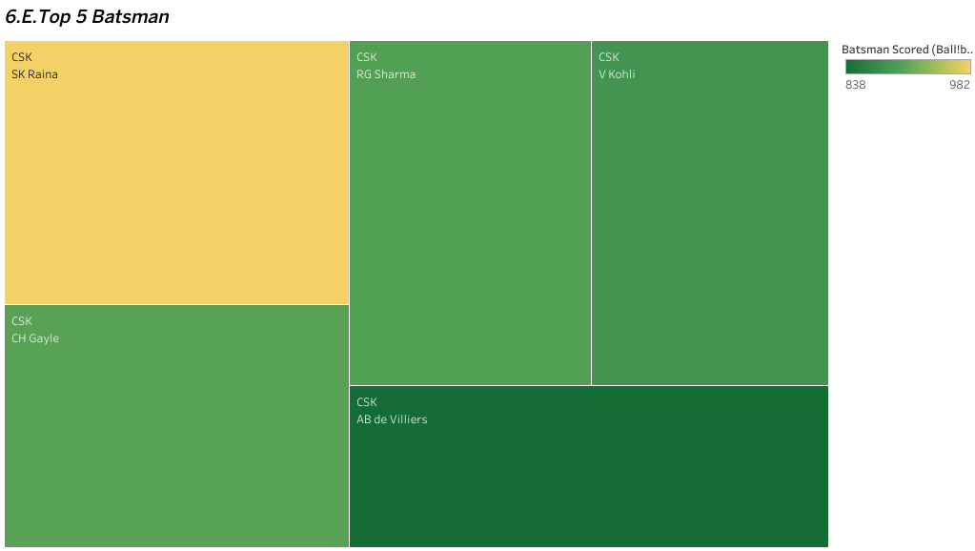

Slide 12
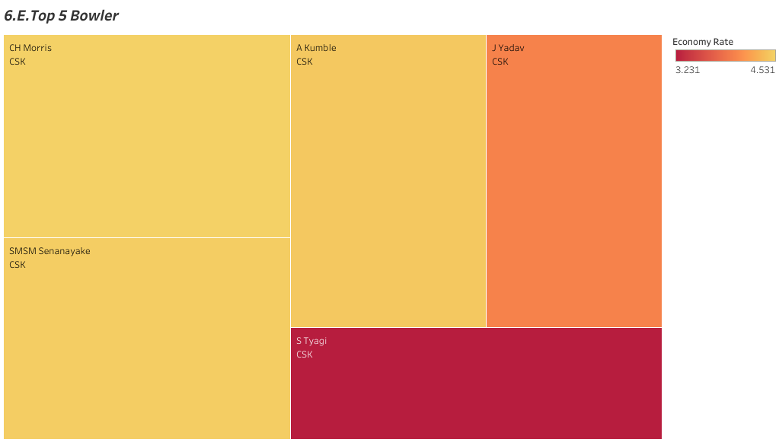

Slide 13
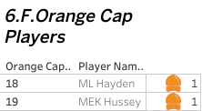

Slide 14
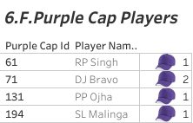

Slide 15
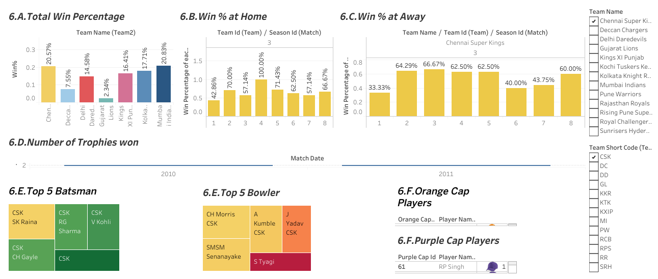

Slide 16
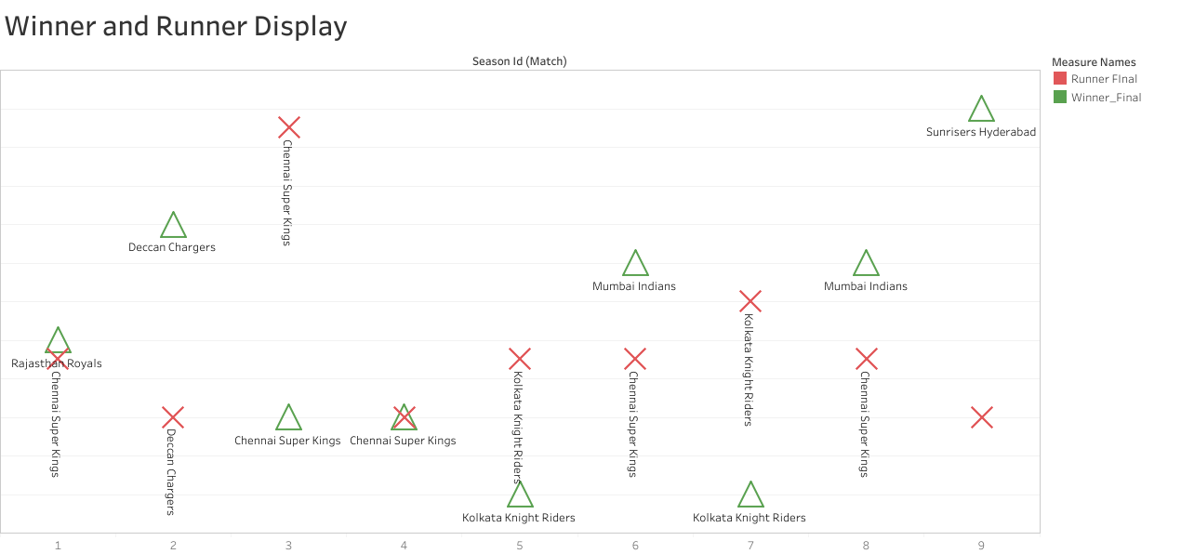

Slide 17
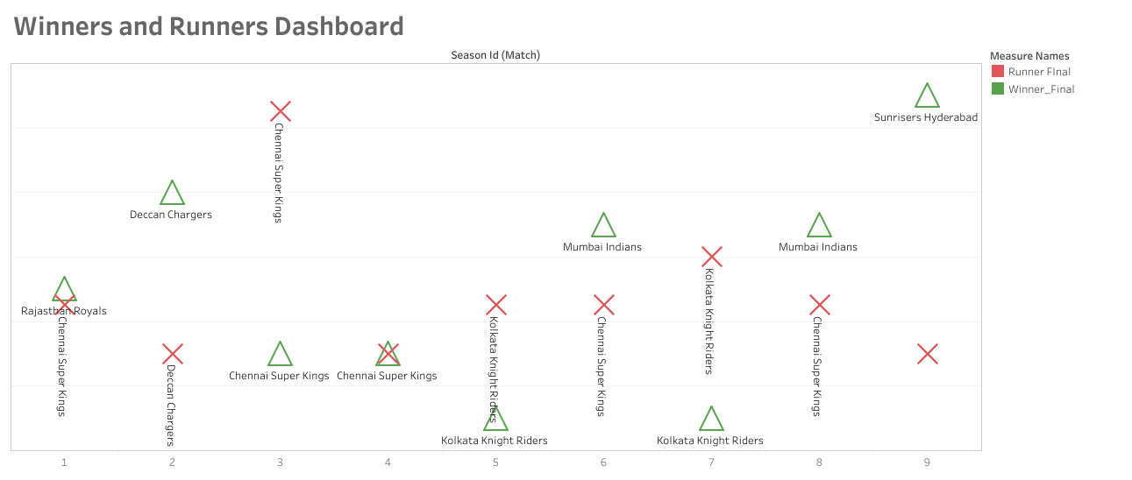

Slide 18
TABLEAU PUBLIC LINK: ALL QUESTION SEPARETELY
https://public.tableau.com/views/PA2312044010024VIJAYANANTHUCT-3Project/TopNScore?:language=en-US&publish=yes&:sid=&:display_count=n&:origin=viz_share_link
https://public.tableau.com/views/PA2312044010024VIJAYANANTHUCT-3Project/TopNWicketTakers?:language=en-US&publish=yes&:sid=&:display_count=n&:origin=viz_share_link
https://public.tableau.com/views/PA2312044010024VIJAYANANTHUCT-3Project/TopNStrikeRates?:language=en-US&publish=yes&:sid=&:display_count=n&:origin=viz_share_link
https://public.tableau.com/views/PA2312044010024VIJAYANANTHUCT-3Project/TopNEconomicBowlers?:language=en-US&publish=yes&:sid=&:display_count=n&:origin=viz_share_link
https://public.tableau.com/views/PA2312044010024VIJAYANANTHUCT-3Project/TopNBowlingPerformance?:language=en-US&publish=yes&:sid=&:display_count=n&:origin=viz_share_link

Slide 19
6. https://public.tableau.com/views/PA2312044010024VIJAYANANTHUCT-3Project_WR/Dashboard1?:language=en-US&publish=yes&:sid=&:display_count=n&:origin=viz_share_link
7. https://public.tableau.com/views/PA2312044010024VIJAYANANTHUCT-3Project_WR/Dashboard2?:language=en-US&publish=yes&:sid=&:display_count=n&:origin=viz_share_link
Url to access the workbook in GitHub
https://github.com/VIJAYANANTH-U/vjananth

